Slide 1

blinkit
BLINKIT DATA ANALYSIS PROJECT
Presented by: Ritesh Kumar
Date: 01-09-2025

Slide 2





PROJECT OVERVIEW
blinkit
Comprehensive analysis of Blinkit's operational data
SQL-powered business intelligence solution
Data from multiple domains: customers, orders, products, delivery, marketing
KEY OBJECTIVES
Customer behaviour analysis
Revenue optimization insights
Operational efficiency assessment
Customer satisfaction analysis
Marketing campaign performance

Slide 3
DATABASE ARCHITECTURE
blinkit
CUSTOMER ORDERS ITEMS
→ → ↘ FEEDBACK PERFORMANCE ↘ PRODUCT
→
CREATE TABLE customer (
customer_id INT PRIMARYKEY,
customer_name VARCHAR(100),
email VARCHAR(100),
phone VARCHAR(20),
address TEXT,
area VARCHAR(100),
pincode INT,
registration_date DATE,
customer_segment VARCHAR(50),
total_orders INT,
avg_order_value DECIMAL(10,2));
CREATE TABLE orders (
order_id BIGINT PRIMARY KEY,
customer_id INT,
order_date DATETIME,
promised_delivery_time DATETIME,
actual_delivery_time DATETIME,
delivery_status VARCHAR(50),
order_total DECIMAL(10,2),
payment_method VARCHAR(50),
delivery_partner_id INT, store_id INT,
FOREIGN KEY (customer_id)
REFERENCES blinkit_cust(customer_id));
CREATE TABLE items ( order_id BIGINT,
product_id INT,
quantity INT,
unit_price DECIMAL(10,2),
PRIMARY KEY (order_id, product_id), FOREIGN KEY (order_id) REFERENCES blinkit_orders(order_id),
FOREIGN KEY (product_id) REFERENCES blinkit_products(product_id));
CREATE TABLE feedback (
feedback_id INT PRIMARY KEY, order_id BIGINT, customer_id INT, rating INT, feedback_text VARCHAR(255), feedback_category VARCHAR(100), sentiment VARCHAR(50), feedback_date DATE,
FOREIGN KEY (order_id) REFERENCES blinkit_orders(order_id),
FOREIGN KEY (customer_id) REFERENCES blinkit_cust(customer_id));
CREATE TABLE performance ( campaign_id INT PRIMARY KEY, campaign_name VARCHAR(100), date DATE, target_audience VARCHAR(50), channel VARCHAR(50), impressions INT, clicks INT, conversions INT, spend DECIMAL(10,2), revenue_generated DECIMAL(10,2), roas DECIMAL(5,2));
CREATE TABLE product ( product_id INT PRIMARY KEY, product_name VARCHAR(100), category VARCHAR(100), brand VARCHAR(100),
price DECIMAL(10,2), mrp DECIMAL(10,2), margin_percentage DECIMAL(5,2), shelf_life_days INT, min_stock_level INT, max_stock_level INT);

Slide 4
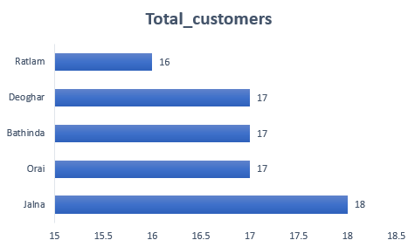
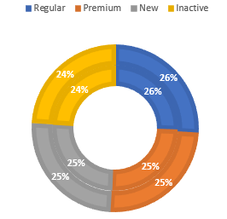
CUSTOMER INSIGHTS
blinkit
TOP 5 AREAS BY CUSTOMER COUNT
Jalna 18
Orai 17
Bathinda 17
Deoghar 17
Ratlam 16
CUSTOMER SEGMENT DISTRIBUTION
Premium - 26%
Regular - 25%
New - 25%
Inactive - 24%

Slide 5
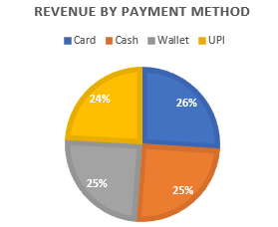
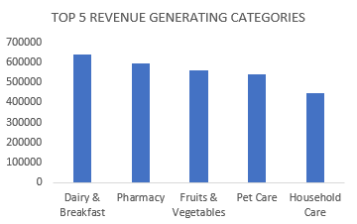
REVENUE ANALYSIS
blinkit
REVENUE BY PAYMENT METHOD (₹)
Crad -₹ 2865557(26%)
Cash -₹ 2770463(25.2%)
Wallet -₹2715004(24.7%)
UPI - ₹2658282(24.1%)
TOP 5 REVENUE GENERATING CATEGORIES
Dairy & Breakfast - ₹ 639222.19
Pharmacy - ₹ 592368.57
3. Fruits & Vegetables - ₹ 559053.08
4. Pet Care - ₹ 539888.75
5. Household Essentials - ₹ 444244.25

Slide 6





PRODUCT ANALYSIS
blinkit
BEST SELLING PRODUCTS (Quantity)
Instant & Frozen Food - 307212
Baby Care - 348227
Grocery & Staples - 359937
Cold Drinks & Juices - 392717
Snacks & Munchies - 394648
AVERAGE BASKET SIZE: 2.01 items per order
2.01

Slide 7
MARKETING ROI ANALYSIS
blinkit
TOP PERFORMING CAMPAIGNS (ROAS > 3)
Campaign | Spend | Revenue | ROAS
Weekend Special | ₹2683.84 | ₹2645.4 | 4
Email Campaign | ₹3599.79 | ₹4311.79 | 4
New User Discount| ₹4683.64 | ₹6103.83 | 4
MOST EFFECTIVE CHANNELS
Mobile App - 2.8
Email - 2.7
Social Media - 2.7
SMS - 2.7

Slide 8
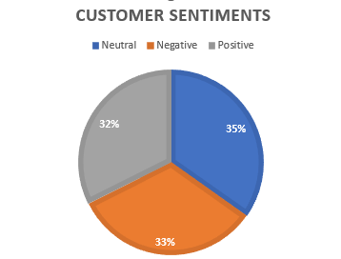
CUSTOMER SATISFACTION
blinkit
SENTIMENT ANALYSIS
● Neutral - 35%
● Positive - 32%
● Negative - 33%
TOP FEEDBACK THEMES
AVERAGE RATING: 3.3/5.0
OTHER
2413
QUALITY
831
DELIVERY
651
SERVICE
457
LATE
182
PRICE
175
PACKAGING
146
FRESH
145

Slide 9
KEY INSIGHTS
blinkit
💰 UPI dominates payments (24% of revenue)
📍Jalna has highest customer concentration
🥛 Dairy & Breakfast is top revenue category
🚚 69.4% on-time delivery rate across stores
📱 Mobile app campaigns have highest ROAS (2.8)
⭐ 32.4% positive customer sentiment

Slide 10
ACTIONABLE RECOMMENDATIONS
blinkit
1. ENHANCE DELIVERY NETWORK
● Target stores with <90% on-time rate
● Optimize delivery routes in high-density areas
2. FOCUS MARKETING EFFORTS
● Increase budget for mobile app campaigns
● Replicate successful Summer Sale strategy
3. IMPROVE CUSTOMER EXPERIENCE
● Address delivery delay concerns
● Implement quality control for fresh products
4. EXPAND HIGH-PERFORMING CATEGORIES
● Increase inventory for Dairy & Snacks
● Promote complementary product bundles

Slide 11
CONCLUSION
blinkit
This analysis provides actionable insights across all business functions, enabling data-driven decision making for growth and optimization.
NEXT STEPS
● Implement recommended strategies
● Establish continuous monitoring dashboard
● Conduct A/B testing for new initiatives
● Expand analysis to include seasonal trends
Q&A
Ritesh Kumar
+91- 8292882529
riteshkumarsingh9363@gmail.com
[

